Slide 1
Poor Man’s Kindle
בס״ד
Presenting: Yagel Gross and Noam Asher

Slide 2
So what is our project and what does it include?
בס״ד
Our project is a private digital library, implemented by using python, for browsing and reading a catalog of books from a remote server. The idea was to use the transport layer protocols to transfer pieces of the book the user is reading, while focusing on reliability and multiple clients connected at once by using threading and smart testing.
The server is able to handle as many clients as needed in theory, and is capable of delivering the packets in 2 ways: either the TCP protocol (much more convenient due to built in multiple connections socket handling and packet chunking), and the RUDP protocol (which is far less intuitive and requires us to handle every client in a unique way through address identification as well as implementing multiple reliability measures).
We have also implemented a DHCP server that will respond to any and all devices seeking an IP address, and a private DNS server with a single private URL handling and upstreaming to Cloudflare otherwise.

Slide 3
So what components comprise our library?
בס״ד
Application Server.
DHCP Server.
DNS Server.
Client (Simple Gui).
3 Objects: Client, DHCPIPPool and Book.
Util class to handle a basic encryption.
Network Manager.
Protocol.
UDP proxy ( to test reliability)

Slide 4
DNS Server
בס״ד
We have implemented a private DNS (partly DoH) server that runs locally on our computer in conjunction with the DHCP and Application servers, so that every client that receives an IP address distributed by our DHCP server will have our DNS server as his DNS server.
In the server, we implemented 1 single private URL, so that if the client is looking to connect to the server and doesn’t know on what IP address it’s located, it can instead enter the URL “books.server” and receive the IP address of the machine where the Application server is running and thus connect to it.
Every other DNS request will be upstreamed to CloudFlare’s servers and receive their answer.
The upstreaming is done by using DoH so that the traffic through the network is secured.

Slide 5
DHCP server
בס״ד
The DHCP server we have implemented is running in conjunction to the router, and is operated thusly: first, we locate the IP base of the network we are using. This is done by sending an empty packet to Google's servers and extracting the IP address from the response. Then, we extract the gateway and netmask by using the netifaces python library. Once we have all of this information, we can initiate an object called DHCPIPPool, that handles an intelligent IP pool.
The server is listening on the DHCP port (67) and responds to every single DHCP request that it catches. It doesn’t always beat the router, but it acts as a backup plan in case the router fails to answer. The way it works is receiving a request, finding an IP address from the pool, sending an ARP packet to that address and verifying it is available, and then broadcasting the offer through the 68 port. If the client replies that it has chosen our IP offer, we respond with a final confirmation, otherwise we do nothing.

Slide 6
Client and Book objects
בס״ד
BOOK
Client
The Book object is a representation of the data we need in order to utilize the file as best and as comfortably as we can.
The parameters included are:
the title.
the author.
how many chapters are in the book, which we utilize to know when there is no longer a need for the prefetch loop.
The file type, less needed in this version but necessary for future extension.
The path to the file itself.
The path to the cover image of the book.
The client object is a representation of the data required for us to work with different users as well as the key to most of the features, such as remembering the last location on each book read.
The parameters included are:
The login credentials: username and password (currently hardcoded into the server, in the future will be moved to a database as an extension).
Whether the client is an admin of the system (currently not used, will be in the future).
The last book the user read.
A dictionary which stores all the books this client has read during the current session of the server as well as the last location he was on each one.
The class also contains getters for easier usage of the data.

Slide 7
Protocol
בס״ד
The protocol we have implemented acts as the shared communication infrastructure between the client and the server for the project, and is operated thusly: first, it establishes all the constants and possible message types for the system, covering everything from login actions and book requests to mid-reading progress updates. The basic structure of a message is formatted using a specific message type followed by data fields, all divided by a predefined separator.
For the data transmission itself, the protocol provides helper functions for two different communication mechanisms. For TCP communication, we utilize a framing mechanism where messages are sent with a fixed 10-digit length header. The send_message and recv_message functions ensure we send and receive the exact number of bytes declared, allowing us to reliably transmit large payloads like entire book chapters.
Concurrently, for RUDP data transfer, the protocol uses the struct library to pack and unpack binary headers. These headers are built with a sequence number, an acknowledgement number, and specific flags (like SYN, ACK, or DATA), and the encoded payload is then seamlessly attached to this header before sending.

Slide 8
Network Manager
בס״ד
The Network Manager class we implemented serves as the core communication hub with the server and is designed to dually support both TCP and RUDP connections. The highlight of this class is the prefetch mechanism, which operates in the background using dedicated threads (_TCP_prefetch_loop and _rudp_prefetch_loop).
This mechanism intelligently monitors the user's reading progress and proactively requests upcoming chapters from the server—defaulting to 5 chapters ahead—into a local buffer, ensuring that the reading experience is completely seamless and ensuring the user doesn’t experience latency issues due to an overloaded network.
Concurrently, for RUDP data transfer, the class runs a continuous listening loop (_rudp_listen_loop) that catches incoming data packets, sends acknowledgements (ACKs), and utilizes a ChapterAssembler object to reconstruct chapters that were split into chunks before updating the user interface. Beyond streaming the actual chapters, the network manager also centralizes all peripheral operations with the server, such as user authentication, fetching the available book list, and synchronizing reading progress.

Slide 9
Application Server
בס״ד
The application server we have implemented acts as the central backend for the project, running both TCP and RUDP services concurrently on separate threads, and is operated thusly:
first, it maintains a repository of authorized users and available e-books (to be transferred to a database in the future), handling incoming login attempts by validating Caesar-ciphered credentials.
When a client requests a specific book, the server utilizes the ebooklib and BeautifulSoup libraries to parse the EPUB files, extracting the HTML content into readable plain text chapters and caching these results in memory to optimize any subsequent requests. To further conserve network bandwidth, it dynamically resizes and compresses book cover images into lightweight base64 strings before sending them.
For clients connected via TCP, the server maintains a persistent streaming loop, delivering full chapters sequentially as requested.
Conversely, to support RUDP connections, the server ensures data reliability utilizing a dedicated background retransmission loop that monitors unacknowledged messages, and intelligently divides large chapter texts into smaller, 500-character chunks to safely navigate UDP size constraints before dispatching them to the client.

Slide 10
Client Side
בס״ד
The graphical user interface we have implemented serves as the interactive frontend for the client, built using the tkinter library, and is operated as follows:
first, the user is greeted by the Login Page, which handles the initial server connection, protocol selection (TCP or RUDP), intelligent DNS resolution for server URLs, and user authentication via the network manager.
Upon successful login, the Start Page acts as a central hub, providing options to either open a local EPUB file or browse the server's library. If the user navigates to the Request Page, the application dynamically generates a visual gallery of available books by decoding base64 cover images, while also prominently displaying a "Continue Reading" button to instantly resume their last accessed book.
The core reading experience is delivered by the Read Page, which seamlessly handles both locally loaded files and live-streamed chapters pulled directly from the network manager's prefetch buffer. To ensure a comfortable user experience, this reading room is highly customizable, offering dynamic font size and family adjustments, toggleable visual themes (such as Dark Mode and Sepia), and automatic right-to-left (RTL) text alignment detection for Hebrew books.
Our goal was to create a user friendly and highly functional frontend basis for future expansion, as this is a project we plan on enhancing further later.

Slide 11
UDP Proxy
בס״ד
To rigorously test the reliability and fault tolerance of our RUDP implementation, we designed and deployed a UDP Chaos Proxy that sits securely between the client and the server.
Instead of connecting directly to the server's RUDP port, the client connects to the proxy (hosted on port 12347), which then intercepts and selectively forwards the traffic to the actual server on a different port (12349). The proxy operates via two concurrent background threads (_forward for Client-to-Server and _reverse for Server-to-Client) that simulate harsh, real-world network conditions.
By configuring command-line arguments, we can artificially inject controlled percentages of packet loss, latency (delay and jitter), and packet duplication into the stream. When a packet is intentionally dropped by the proxy, it generates and sends a specialized "##DROPPED##" marker payload.
This clever addition allows us to use network analyzers like Wireshark to visually identify exactly which packets were lost in transit and verify that our RUDP retransmission loops successfully recovered the missing data, ensuring the application remains robust even under severe network instability.

Slide 12

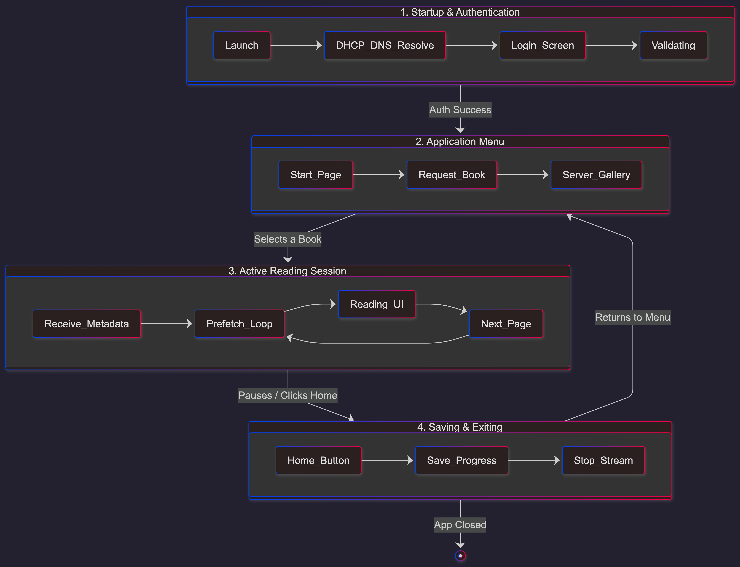
A state diagram for the full system
בס״ד

Slide 13
Overcoming latency issues
Client-Side Prefetching: The Network Manager runs dedicated background threads (_TCP_prefetch_loop and _rudp_prefetch_loop) that continuously fetch upcoming chapters. By maintaining a buffer of 5 chapters ahead of the user's current position, page turns are instant and unaffected by network dips.
Server-Side Memory Caching: Parsing EPUB files and extracting text via BeautifulSoup is resource-intensive. The server parses a book only once and stores the text array in an internal dictionary (book_cache), delivering instant responses for any subsequent requests for that same book.
Thumbnail Compression: To prevent the Request Page gallery from causing network bottlenecks, the server dynamically resizes book covers into lightweight 100x130 thumbnails and applies heavy JPEG compression before transmitting them as base64 strings.

Slide 14
Overcoming packet loss (RUDP)
Sequence & Acknowledgment System: Every RUDP data packet carries a unique Sequence Number in its binary header. The receiving side is required to immediately fire back an ACK packet matching that specific sequence number.
Dedicated Retransmission Loop: The server utilizes a background thread (udp_retransmission_loop) that actively monitors a dictionary of unacknowledged messages. If an ACK is not received within a 0.5-second timeout, the server automatically retransmits the missing packet.
Retry Limits: To prevent infinite hanging on disconnected clients, the retransmission loop gives up and drops the packet after 5 unsuccessful attempts.
Client-Side Safety Nets: Critical client requests (like login attempts or fetching the book list) are wrapped in localized reliability loops. If the server_response_event isn't triggered within a few seconds, the client assumes the request was lost and resends it.

Slide 15
External Libraries & AI Code Declaration
External Libraries (Git/Pip): ebooklib & BeautifulSoup (bs4): Used to parse EPUB files and extract readable HTML text.
scapy: Utilized in the DHCP server to craft and send raw ARP and BOOTP packets.
netifaces: Used to dynamically retrieve the host machine's gateway and subnet mask.
Pillow (PIL): Used for resizing and compressing book cover images.
dnspython: Employed for intelligent DNS resolution in the client.
tkinter: The standard Python library used to build the Graphical User Interface.
AI-Generated Code: * In the DHCP server implementation (DHCP.py), lines 40 to 47 were generated by AI.
Why we used it: We needed to dynamically extract the default gateway and netmask to configure the DHCP IP Pool. We were not previously familiar with the netifaces library, so we used AI to generate the specific syntax required to pull this data from the gws and addrs dictionaries.
Additionally, a few parts of the GUI were AI generated, until we learned the syntax.

Slide 16
Summary & Future Expansion (Scalability)
Database Integration: The current application uses hardcoded lists for authorized users and available books. To scale, we plan to migrate this data to a structured, secure database (like SQLite or PostgreSQL) to manage thousands of user accounts and massive digital libraries.
Admin Control Panel: The Client object already includes a dormant boolean flag for admin privileges. We plan to build a dedicated dashboard allowing administrators to upload new books, monitor network traffic, and manage user access seamlessly.
Expanded Format Support: The server's parsing engine is currently built around EPUBs. Future versions will be extended to support and stream other popular document types, such as PDF, MOBI, or raw TXT files.
Handling Massive Concurrency: The current server architecture spawns a new thread for every connected TCP client and every incoming RUDP request. While this works beautifully for a small network and a limited number of clients, probably up to a few hundreds, it isn’t enough for a legitimate library that might need to handle tens of thousands of client, so we will need to explore our options on how to expand this.

